Slide 1
Terminal, Git and Github basics

Slide 2
What is Terminal? And what’s a command?
The Terminal app allows you to control your Mac using a command prompt. Terminal is a Mac command line interface. Command Prompt is on Windows.
To use the terminal, you use commands. A command is made up of three elements:
The command itself
An argument - tells the command what resource it should operate on
A modifier - An option that changes the output.
Notes:
https://macpaw.com/how-to/use-terminal-on-mac

Slide 3
Terminal example
To move a file from one folder to another on your Mac, you’d use the move command `mv` and then type the location of the file you want to move, including the file name and the location where you want to move it to.
$ [command] [sp] [location of the file] [sp] [file name] $ mv test.txt dir/test.txt

Slide 4
Useful commands
`ls` - Lists the names of the files in the working directory.
`cd directoryname` - Changes the working directory to the one you named.
`cd ..` - Brings you up one directory level.
`cd` - Returns you to your home directory.
`pwd` - Displays the pathname of the current directory.
`mkdir newdirectoryname` - Makes a new directory.
`rmdir directoryname` - Removes (deletes) an empty directory.
`touch filename` - Creates a new file name.
`rm filename` - Removes (deletes) a file.
`open .` - Opens current folder in finder
Also works with a directory name
Notes:
https://www.dummies.com/computers/macs/mac-operating-systems/how-to-use-basic-unix-commands-to-work-in-terminal-on-your-mac/
https://www.techrepublic.com/article/16-terminal-commands-every-user-should-know/

Slide 5
Let’s try it
Open your terminal
Open your home director (this is the folder you’re already in) in your finder
Make a new directory named `code`
Change directories into your `code` folder
Make a file named `test.txt`
Make a folder named `testdir`
Move `test.txt` into `testdir`
Change directories into the `testdir` folder
Open `test.txt` in Atom
Type “This is a test” and save the file

Slide 6
What is Git?
Git is a version control system for tracking changes in computer files and coordinating work on those files among multiple people.
Primarily used for source code management in software development,[9] but it can be used to keep track of changes in any set of files.
Open source

Slide 7
Why use Git?
Revert to past versions of projects
Git allows us to make save points at any time. These save points are called 'commits'.
Keep track of what each change and version is
Every commit has a description (commit message), which allows us to describe what changes were made between the current and previous commit.
Compare changes to past versions
Git allows us to easily see these changes (called a diff) for any given commit.
Make changes without being nervous
Git makes it easy to go back (revert) to a known good state, we can experiment without worrying that we'll be unable to undo the experimental work.

Slide 8
Setting up Git
1. Install XCode Command Line Tools
xcode-select --install
2. Open Terminal and check if git is installed
git --version
Notes:
https://github.com/code4policy/modules/blob/master/git/02-setup.md

Slide 9
Setting up Git (pt. 2)
1. Configure `git` with your name and email address. Be sure to use the same email address associated with your Github account.
git config --global user.name "YOUR NAME" git config --global user.email "YOUR EMAIL ADDRESS"
Notes:
https://github.com/code4policy/modules/blob/master/git/02-setup.md

Slide 10
Connecting Terminal to Atom
1. Open Atom
2. Click `Atom` menu in top left corner
3. Click `Install Shell Commands`
4. Open Terminal and type `which atom`. It should return `/usr/local/bin/atom`
5. Type `atom .` to open that directory in Atom
Notes:
http://tutorials.jumpstartlab.com/academy/workshops/terminal_and_editor.html

Slide 11
Basic vocabulary
Git - version control software
Repository - a folder containing your files and also containing a structure that helps keep track of changes in those files. When you initialize a repository, git creates a hidden folder (.git folder) that stores the changes to those files.
GitHub - a place to host git repositories and collaborate
Local Repository - the version of a git repository on your local computer
Remote Repository - the version of a git repository stored somewhere else that your local repository is connected to (frequently on GitHub)
Commit - the basic unit of a git repository is a commit. It is a set of changes to a file. A commit usually comes with an id as well as a commit message that describes the change.

Slide 12
Basic vocabulary (pt. 2)
Untracked Changes - files that are in your folder but that git doesn't pay attention to.
Staging Area - a place where you can put files before you commit them. Once files are in the staging area, git is paying attention to them.
Commit Log (aka Git History) - all of the commits (previous changes) to all of the files in your repository.

Slide 13
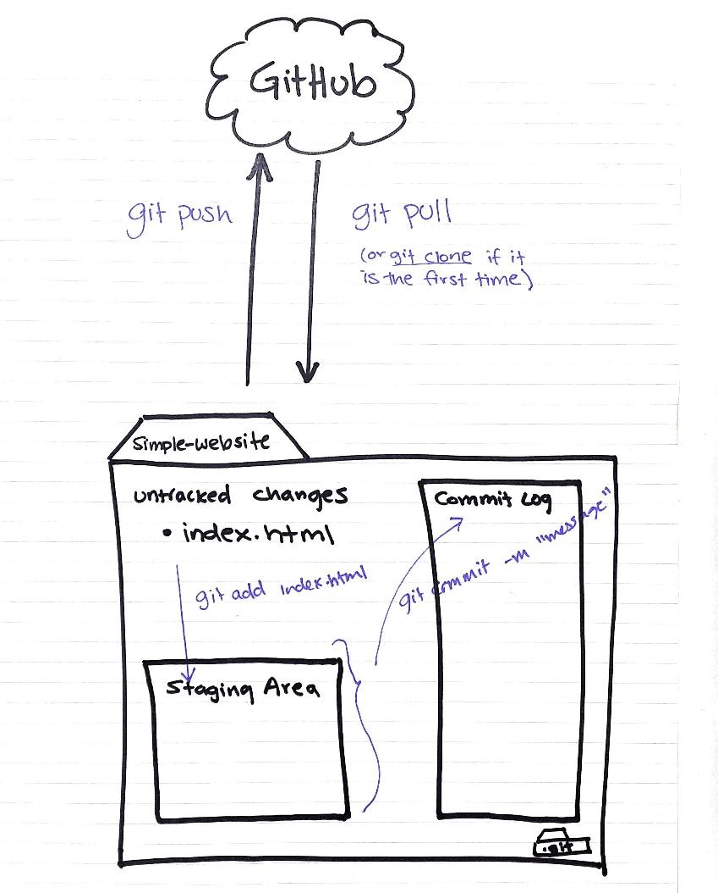
Components of a Git Repository
The working directory
`git init`creates a git repo inside current working directory
The staging area
`git add .` adds changes from the working directory to the staging area
`git add <filename>` adds changes to filenames specified from the working directory to the staging area.
The commit
`git commit -m "commit message"` adds changes in staging area to the repository
Protip: Run `git status` after each command as you get comfortable with the steps

Slide 14
Key commands and terms
github - a service that hosts git remote repositories, and provides a web app to interact / collaborate on them
remote - another repository that can be synchronized with a remote
origin - the name for a remote read-and-write repository
clone - download an entire remote repository, to be used as a local repository
pull - fetching changes and merging them into the current branch
push - puts changes in remote repository

Slide 15
A repository is used to hold and organize files
A repository is usually used to organize a single project.
Repositories can contain folders and files, images, videos, spreadsheets, and data sets – anything your project needs.
You should always include a README (a file with information about your project) in your repositories.

Slide 16
Let’s set up your class repository
In your terminal
Move into your `code` directory
Delete your `testdir`
Then, let’s go to Github

Slide 17
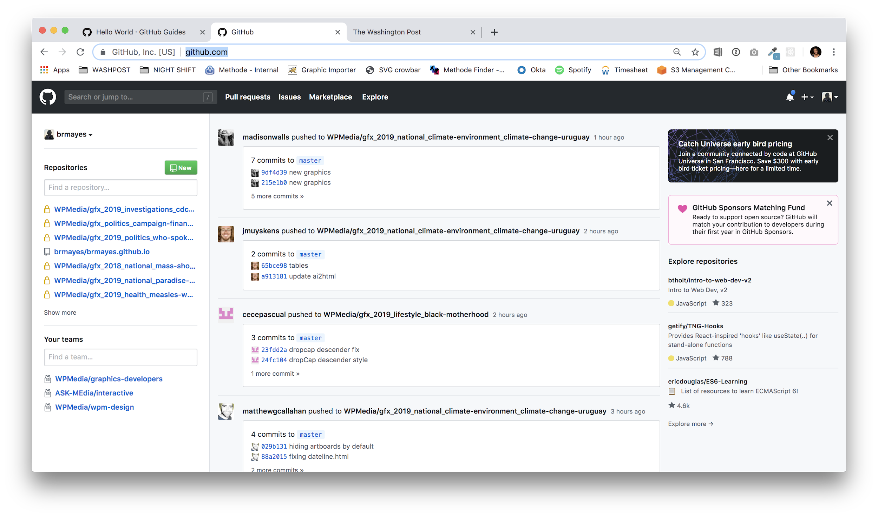
How to create a repository using Github.com
Go to Github.com

Slide 18
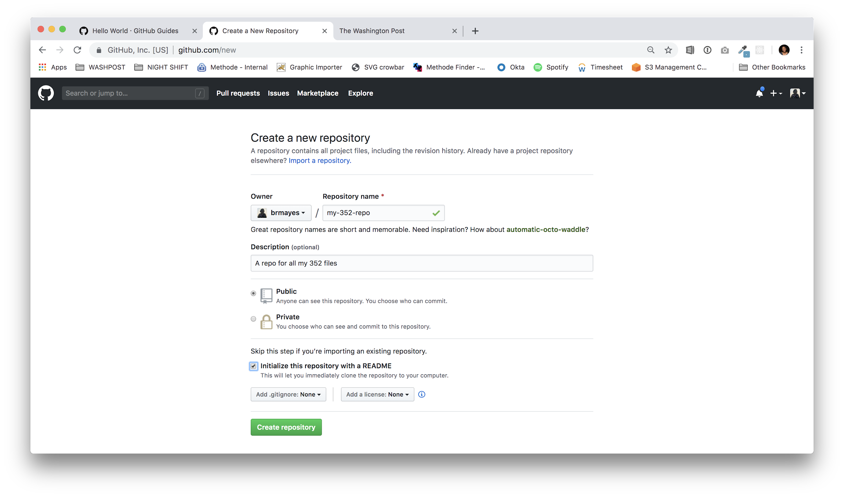
How to create a repository using Github.com
2. Fill out repository details then press create
initialize WITH a readme

Slide 19
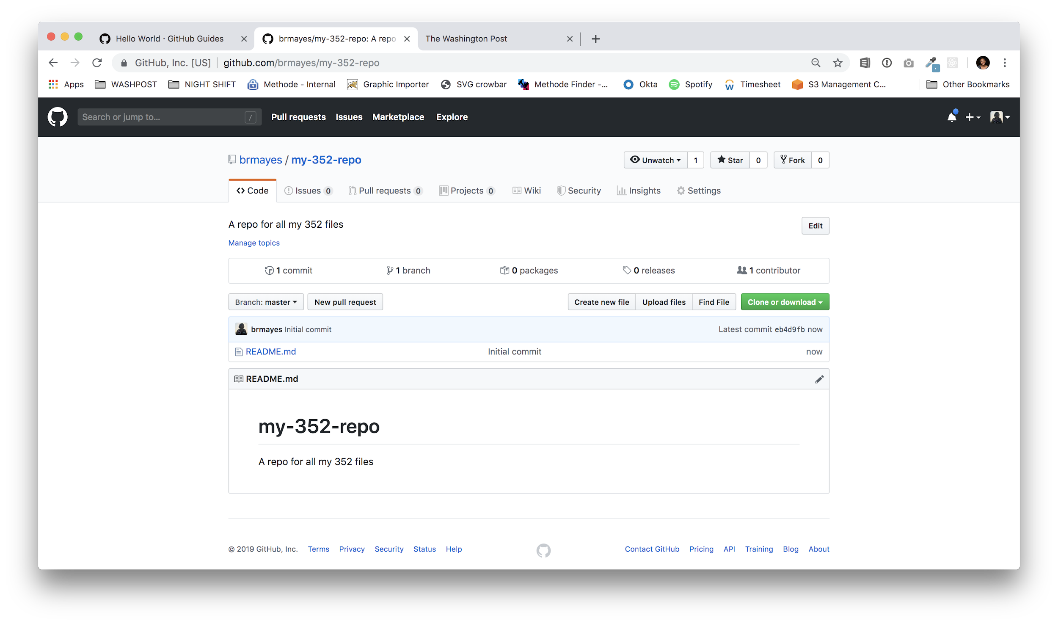
How to create a repository using Github.com
3. Done!

Slide 20
How to clone a repository
1. Press `Clone or download`

Slide 21
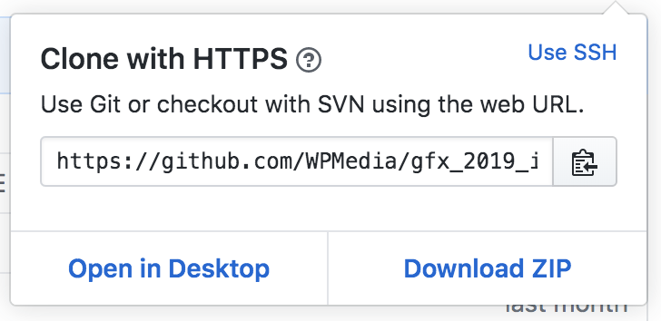
How to clone a repository
2. Copy the URL

Slide 22
How to clone a repository
3. Type `git clone [paste URL]`
Done!
$ git clone https://github.com/brmayes/jour352.git

Slide 23
Create a landing page in your repo
In your terminal, change directories into your `jour352` folder
Create an `index.html` file
Open in Atom
Add in the text on the right ->
Save
Return to terminal
<!DOCTYPE html> <html> <head> <title>JOUR352</title> </head> <body> <h1>Hello, World</h1> </body> </html>

Slide 24
How to modify a repository after you’ve made a change in your text editor
1. Add the files: `git add .`
2. Commit the files: `git commit -m “add index file”`
3. Push to Github: `git push origin master`
“master” is the branch you’re working on

Slide 25
Wait, what are branches?
Branches are separate development environments use to store unique code.
At the end of the day, only the master branch matters. That’s where all the code will be merged into.
No, you don’t have to use branches. Yes, it will help if you’re trying to add functionality without the possibility of messing other aspects of your code up.

Slide 26
In-class assignment time!
Follow the instructions on Github Pages to make your personal website. Use these options:
User or Organization site/Project site: User or Organization site
Step one needs to be followed exactly or this won’t work.
What git client are you using? A terminal
Clone the repository into your `code` folder
Follow steps 3-5 and submit your URL when finished.

